Slide 1
Newegg Database Architecture
Wison.W.He
10/24/2014

Slide 2
Agenda
Background
Statistics
About DBA Team
QA

Slide 3




Background
Manage 200 database servers; Hadoop/Cassandra/MongoDB/Mysql
Manage 100 + database servers; New Hadoop/Cassandra/Mysql
Now
2011
DBA Team formed, manage 20 database servers
SQL Server 2000
2005
2001

Slide 4
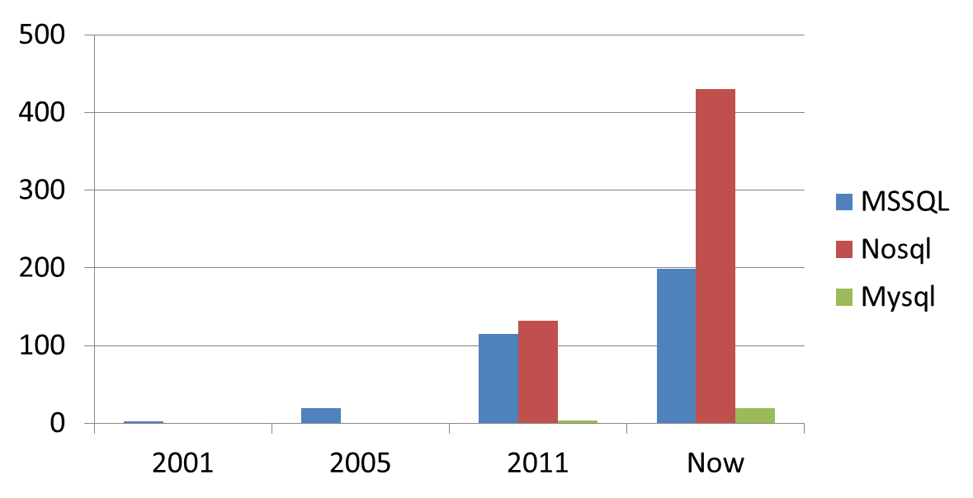
Statistics
Year | MSSQL | Nosql | Mysql
2001 | 2 | 0 | 0
2005 | 19 | 0 | 0
2011 | 115 | 132 | 4
Now | 199 | 430 | 19

Slide 5
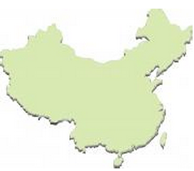
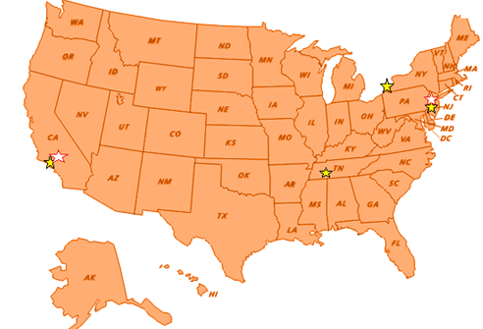
Statistics
By Location
S7
Newegg.com
E4
Newegg.cn
E3
E5
E10
Newegg.com.tw

Slide 6

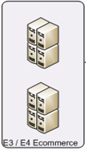
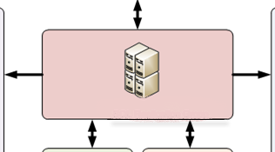
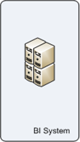
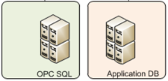
Statistics
By Group
SQL RPL/SSB Group

Slide 7





Statistics
By Technology

Slide 8
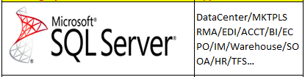
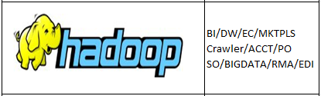
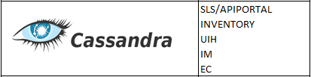


Statistics

Slide 9
About DBA Team
SAO(Henry Hsu)
US DBA
MSSQL/Mysql
Hadoop/Cassanda
MongoDB
CN DBA
MSSQL
Hadoop
TW DBA
MSSQL
Cassanda
MongoDB

Slide 10
About DBA Team
* GP team mis nesc cncd dba

Slide 11
The End.

